Slide 1
AUTOMATING KOJI BUILD SYSTEM FOR BUILDING RPMs

Slide 2
Overview
Package and Package Management
RPM YUM and DNF
Chroot and Containers
Mock
Koji

Slide 3
What’s a package?
A package is a compressed archive file containing all the files included with an application.
Packages can be a command-line utility, a GUI application or a library.

Slide 4
Dependencies
Package B
Package C
Package A
Package D
Package E
Package F

Slide 5
Package Managers
A package manager or package-management system is a collection of software tools that automates the process of installing, upgrading, configuring, and removing computer programs for a computer in a consistent manner.

Slide 6
RPM
RPM (Red Hat Package Manager) is a package management system used primarily in Linux distributions.
RPM packages contain compiled software, documentation, and installation scripts.
It handles package installation, querying, verification, and removal.

Slide 7
Most RPM files are "binary RPMs" (or BRPMs) containing the compiled version of some software.
There are also "source RPMs" (or SRPMs) containing the source code used to build a binary package.
Installing package rpm -i package.rpm
Deleting Package rpm -e package
Updating package rpm -U package.rpm

Slide 8
YUM & DNF
Both YUM and DNF are used to manage software packages in Linux systems.
They simplify the process of software installation, update, and removal, while also handling dependencies to ensure that all required components are installed correctly.
DNF is the next-generation version of YUM, introduced in Fedora 18 and later versions.

Slide 9
YUM commands:
$ yum install package.rpm
$ yum remove package
$ yum update package.rpm
DNF commands:
$ dnf install package.rpm
$ dnf remove package
$ dnf update package.rpm

Slide 10
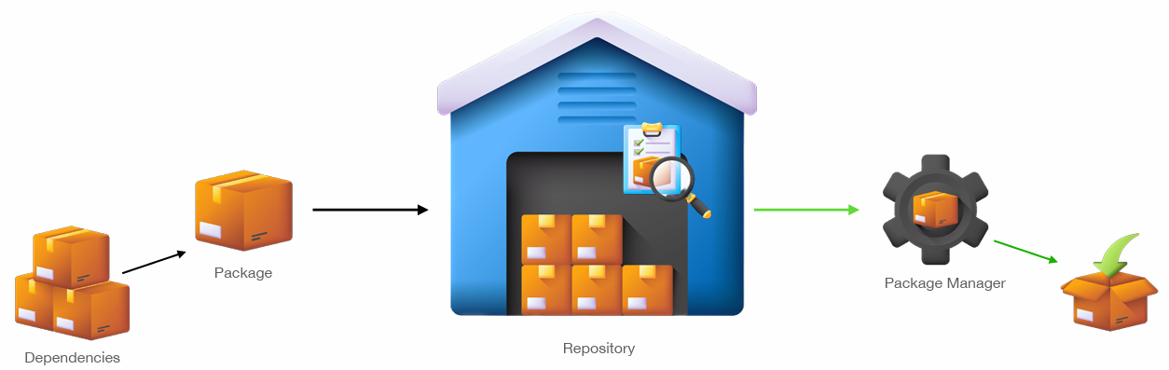
YUM installs packages from repositories.
YUM can resolve dependencies by downloading them from repositories.

Slide 11
chroot
chroot stands for "change root"
Fake root directory
Dependency control
Library segregation

Slide 12
bin
etc
home
user
user
chroot
Home
etc
bin
/
Satya
prakash

Slide 13
Containers
Containers provide a flexible and reliable solution for building packages, offering benefits such as isolation, consistency, dependency management, portability, and scalability.

Slide 14
Mock
Mock simplifies the package building process by providing a clean and isolated environment with automatic dependency resolution.
Mock is a wrapper around rpmbuild. It takes srpms and builds package in a clean chroot / container.

Slide 15
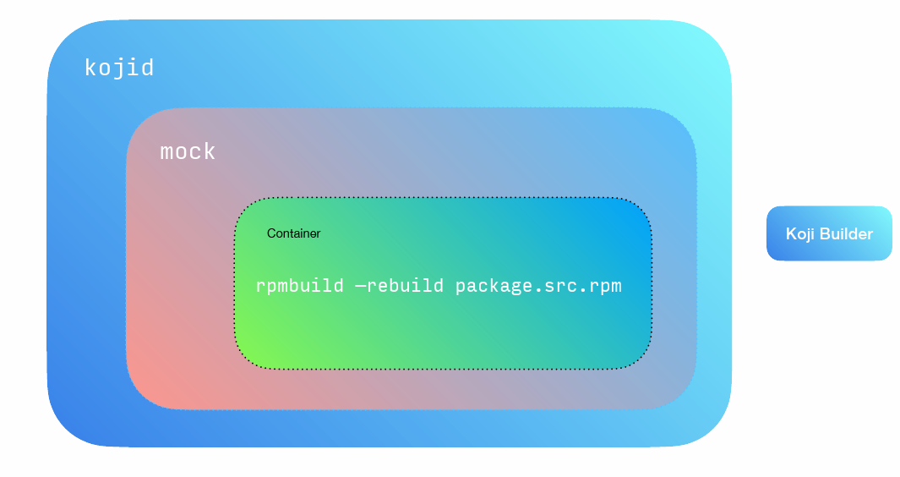

Slide 16
Koji
Koji is the central build system that builds RPM packages for the Fedora project.
It uses Mock to create chroot / containerized environments to perform builds.
It also schedules tasks and tracks results.
Task System : Build binaries from source code
Object store : Store built packages
Tag System : Organize contents by tag

Slide 17
Tags and Target
Tag :
A tag is a collection of packages.
Tags contain metadata such as tracking data like target-architecture, repositories etc.
Tags can be inherited. Eg, tagA inherits packages from tagB
Target :
A target is a pair of tags - the build tag plus destination tag.
A target specifies where a package should be built and how it should be tagged afterward.
This allows target names to remain fixed as tags change through releases.

Slide 18
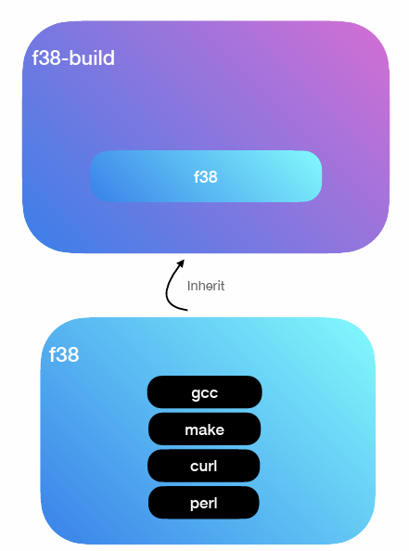
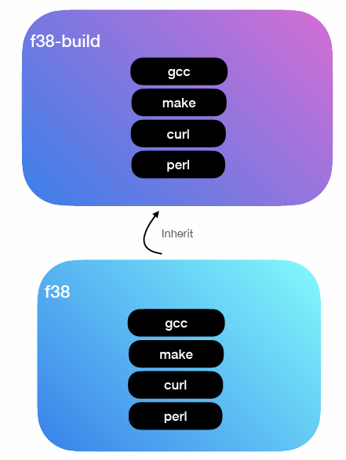
Tag
Tag

Slide 19
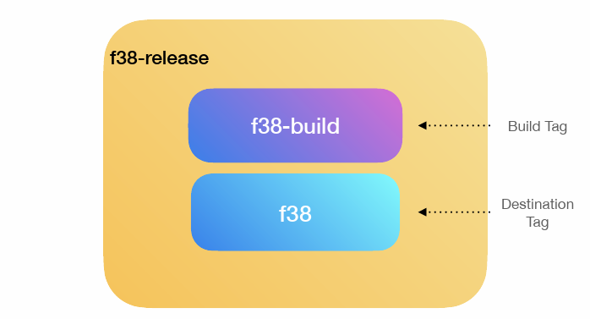
Target

Slide 20
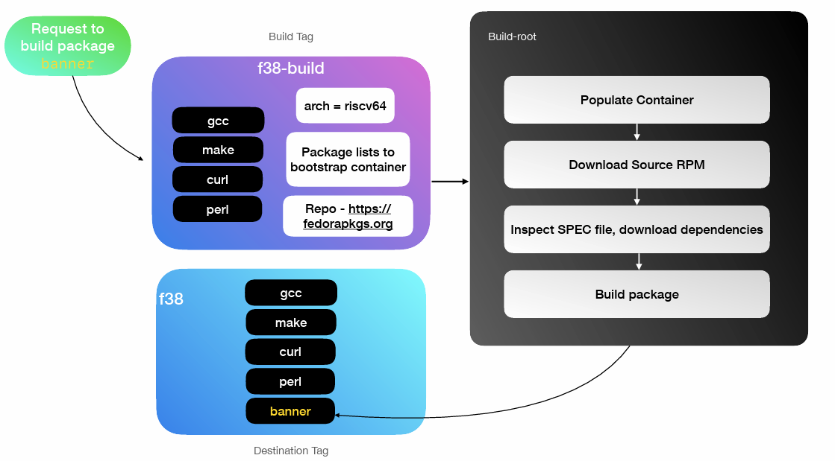

Slide 21
Koji Components
• Koji-Hub
• Koji-Client
• Koji Builder (kojid)
• Kojira
• Koji-Web

Slide 22
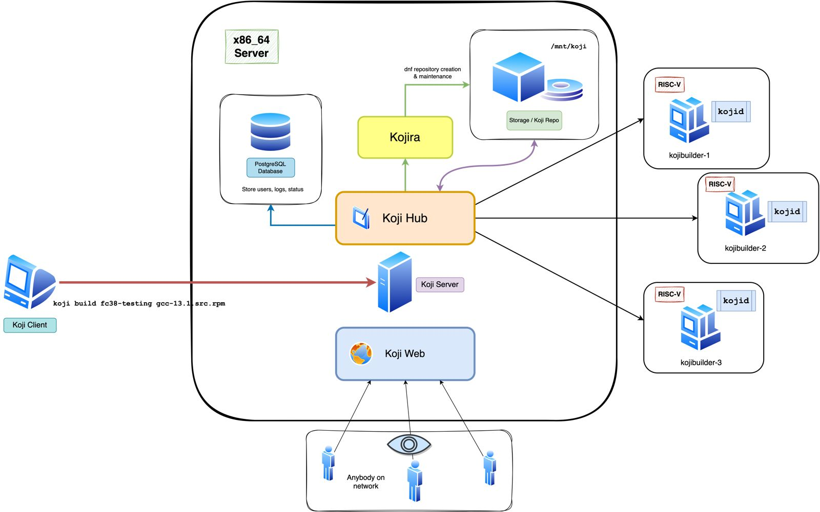

Slide 24
RPM package building
Ensure you have the necessary development tools installed on your system
Place the source code of your software in the SOURCES directory
Preparation
Source Code
It specifies how the source code should be built and packaged.
Start the build with source code and spec file
Spec File
Building

Slide 25
Git Server
Koji Hub
Source Code
+
Patches
+
Spec file
Repository link
+
Commit id
+
Build command
target, srpm / url to spec file
Koji build <Target Name> <Repository URL>

Slide 26
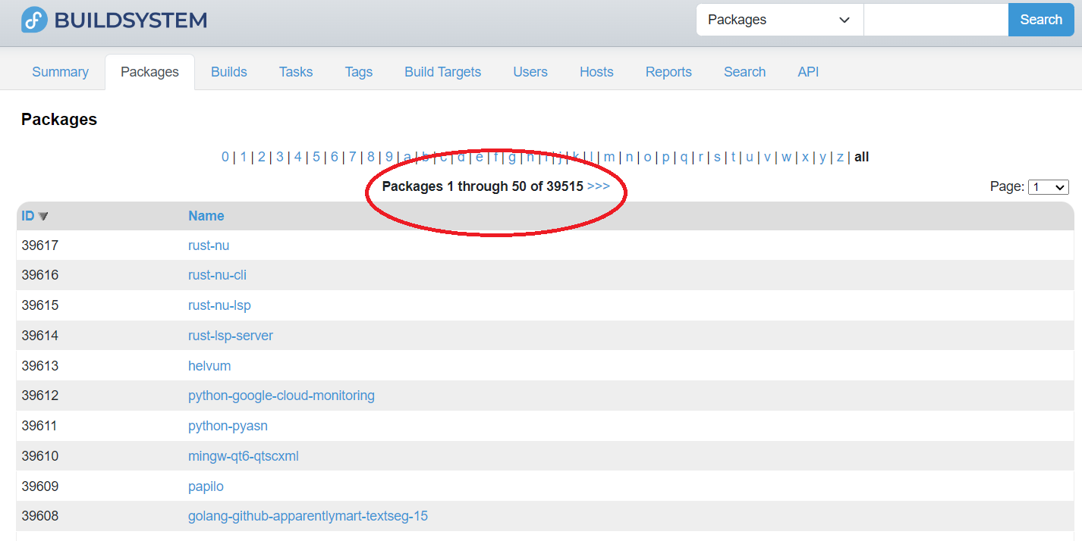

Slide 27
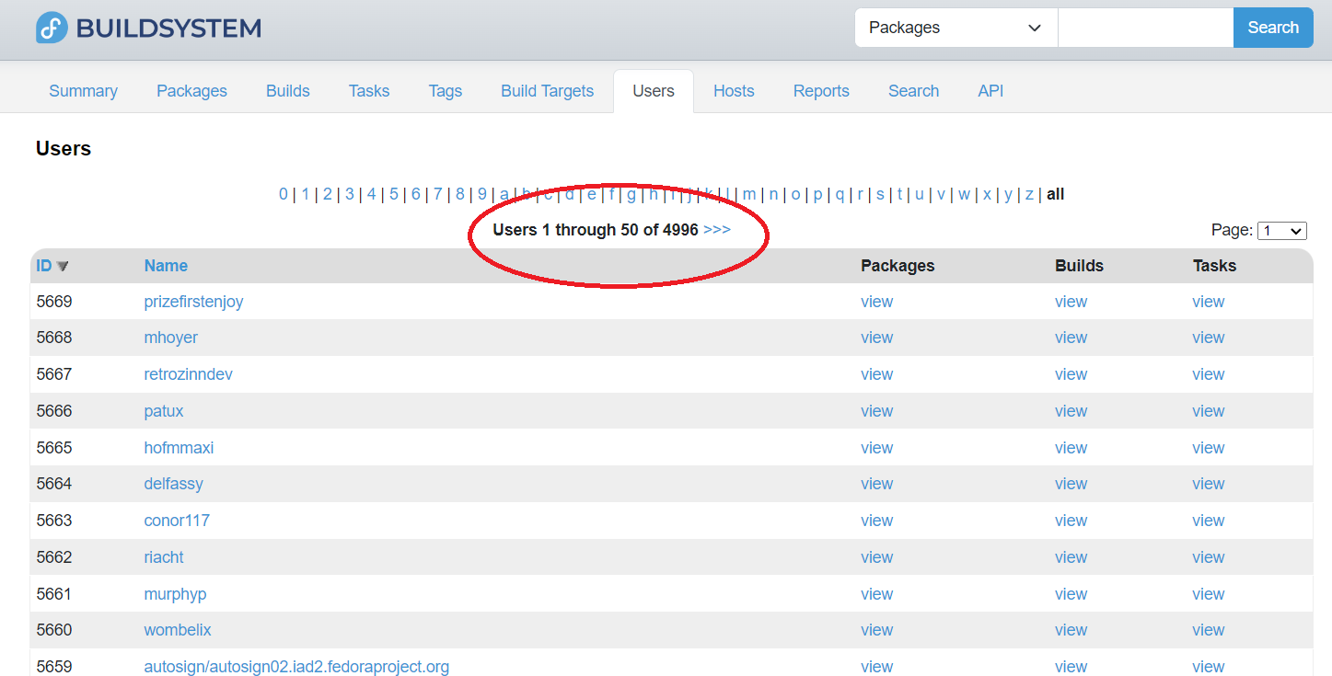

Slide 28
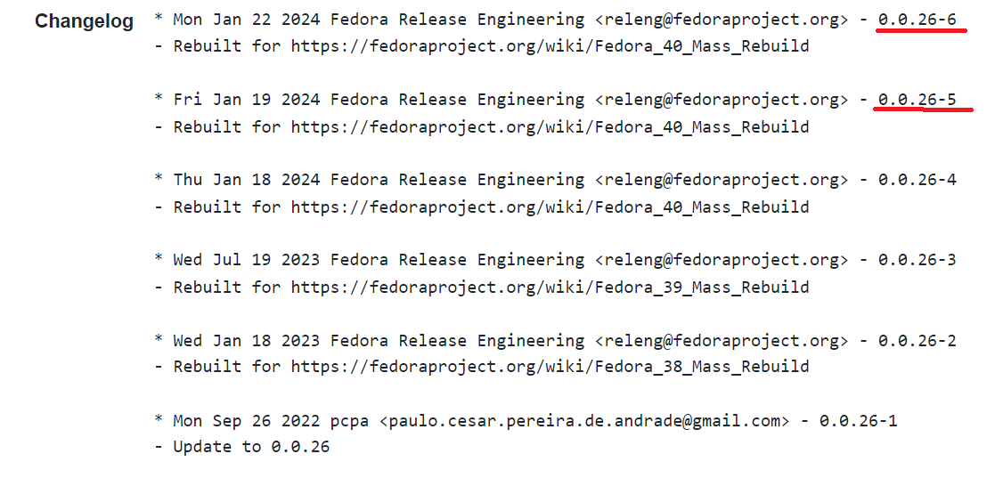
Mass Rebuild

Slide 29
Let’s Automate the builds !!
Gitea Server
Source code
Webhook
Tornado
Build method
Koji server
ngrok
Class xyz:
def method1()
…………
………….
def method2()
Koji Hub
Reverse proxy
Builder
Python application
Package ready

Slide 30
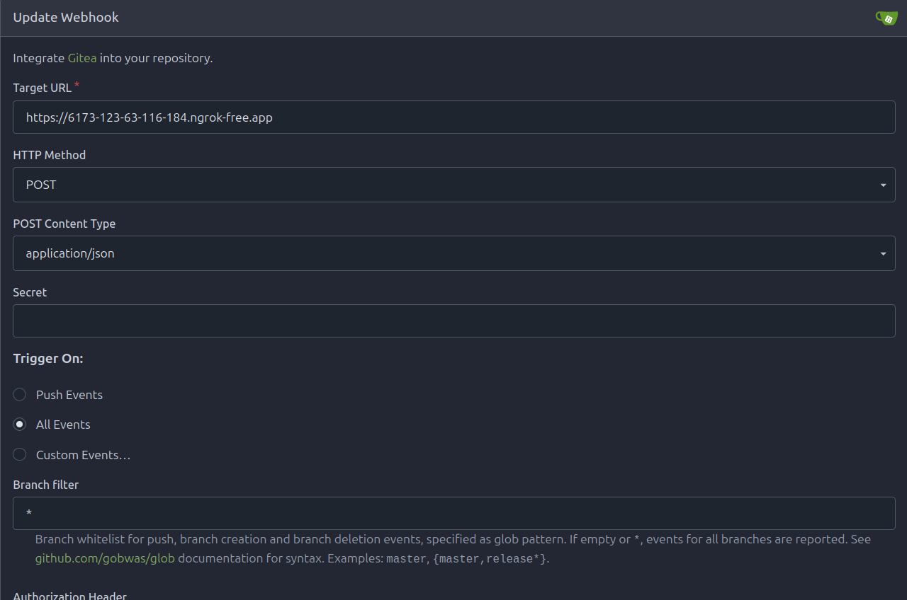
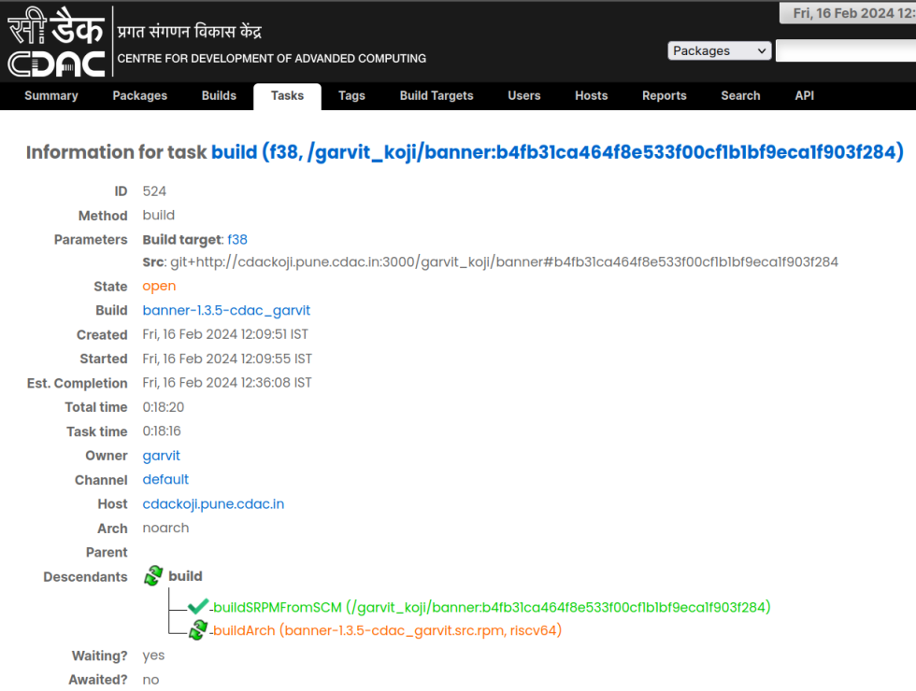
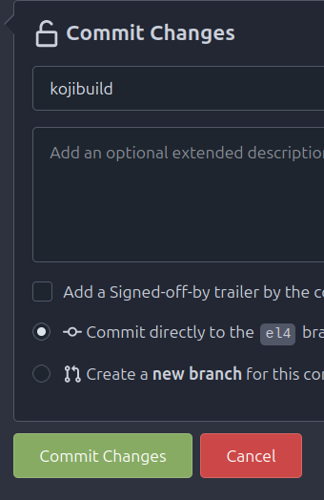
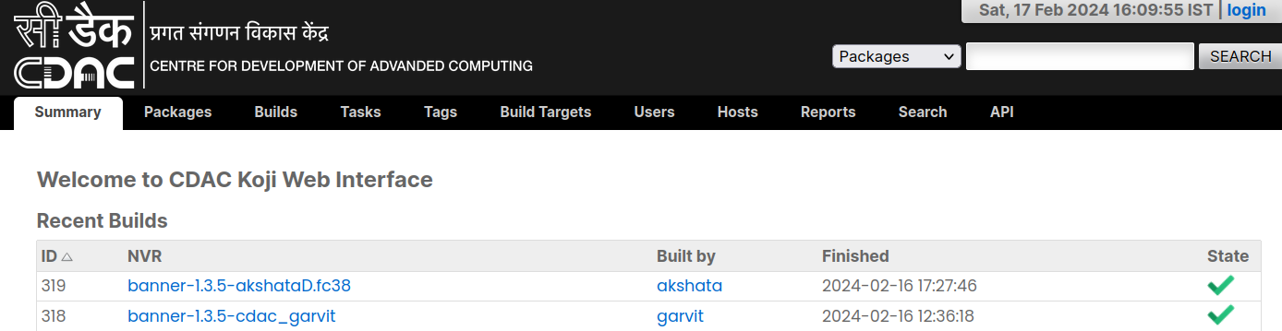

Slide 31
THANK YOU

